Slide 1
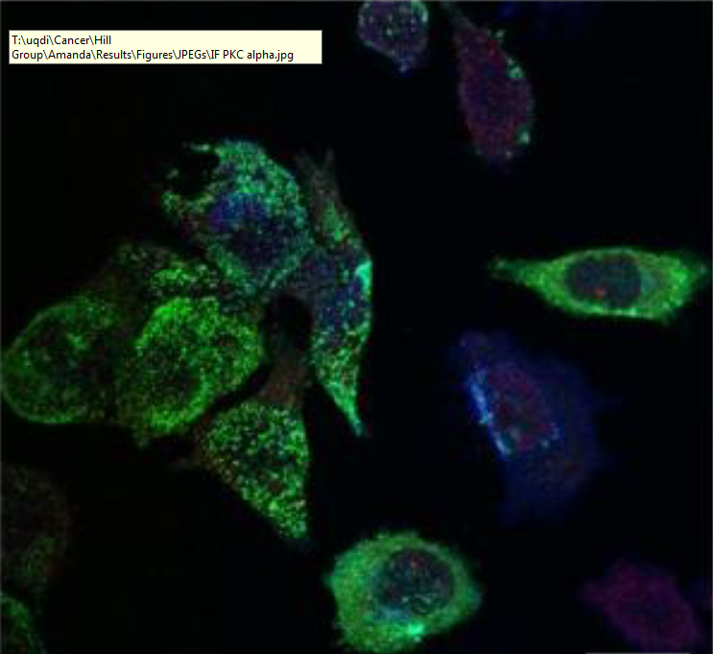
Investigating the mechanism of selective microRNA export via extracellular vesicles
Harley Robinson
Supervisor: A/Prof Michelle Hill
Co-supervisor: Dr Alex Cristino

Slide 2
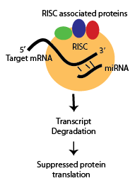
microRNAs
Important regulatory function
Binding to target mRNA decreases protein function by RISC inhibition and degradation (Gregory et al. 2005)
Export of microRNAs (miRs, miRNAs) regulates pathways in the recipient cells

Slide 3
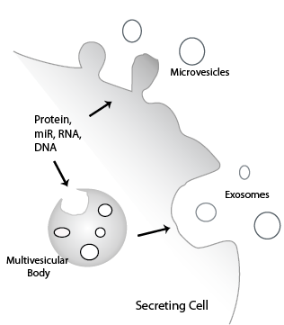
Extracellular Vesicles
Comprised of microvesicles and exosomes.
Increased stability of contents compared to unbound secretion into extracellular serum
Important for intercellular communication.
Notes:
What, contents, advantages.. Hereby, investigating the content can reveal function or irregularities occurring in intercellular communication

Slide 4
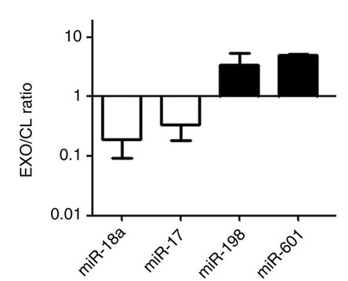
Current miRNA Cargo Sorting Mechanisms.
Previously considered non-selective
miRNAs exported can change disproportionally to the cellular content
Sumoylated hnRNP A2B1 involved in miRNA export via exosomes. (Villarroya-Beltri et al 2013)
Regulation of export still unknown
(Villarroya-Beltri et al 2013)
Notes:
Very little is known about miRNA export. Previously non-selective (define). Link to slide as selective. hnRNP subset of 30miRs. No known regulation, no known mechanisms for the other miRs

Slide 5
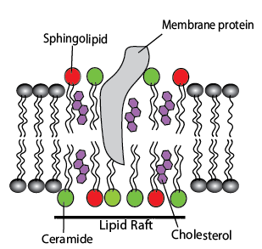
Lipid Rafts Affecting Cargo Sorting
Sorting may be impacted by lipid raft composition.
Both types of EVs contain cholesterol, sphingolipid and ceramide enriched microdomains.
Depletion of cholesterol, ceramide and sphingolipid modified EV protein content. (Leyt et al 2007; Trajkovic et al 2008; Phuyal et al 2014)
Notes:
Lipid raft composition may be key.. Lipid rafts are.. Rafts enriched in.. Investigating the role of these lipid rafts through depletion..

Slide 6
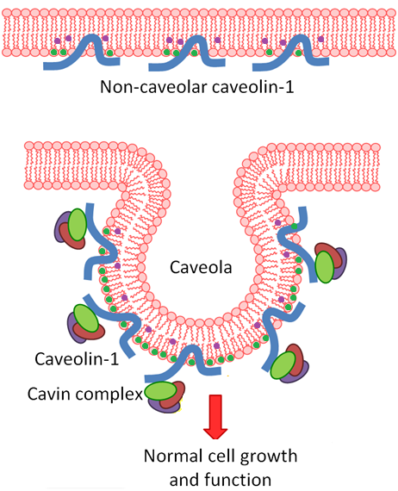
Experimental Model: Cavin-1 in PC3 Cells.
Increased Caveolin-1 expression without Cavins in PC3.
Caveolin-1 is a cholesterol transporter
When accompanied by Cavin-1 it will form caveolae, utilised in Endocytosis.
Enrichment of Caveolin-1 on EVs

Slide 7
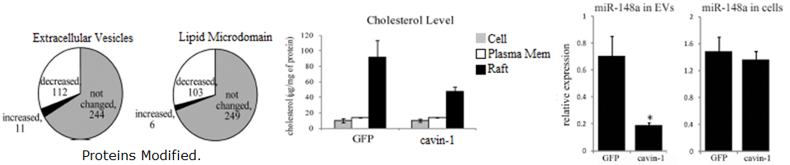
Cavins and Export
Introduction of Cavin-1 results in modulated cholesterol re-distribution, EV protein content and miR content.
Hereby, modulation of miRNA export is dependent of lipid raft composition.
(Inder et al 2012; Inder et al 2014)

Slide 8
Hypotheses and Aims:
Hypothesis:
EV miRNA content is mediated by RNA-binding proteins modulated by lipid raft composition.
Aims:
Identify the selectively exported miRNAs
Identify RNA-binding proteins correlated to the miRNA export
Verify candidate miRNA escort proteins ability to bind to miRNAs and transport to EVs.

Slide 9
Aim 1: Analysis of miRNA Export
Method 1: Bioinformatics
miRNA-seq data compiled: GFP-PC3 and GFP:Cavin1-PC3 cells, EVs and cell pellet
DEseq2 and egdeR find differences in miRNA levels between cell lines
Compare between cell and EV to find selectively exported miRNAs.
Method 2: RT-qPCR

Slide 10
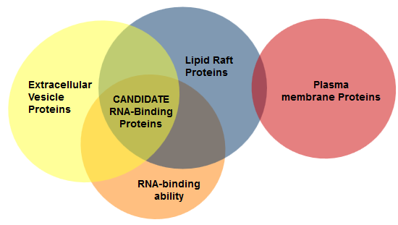
Aim 2: Identify Candidate miR Binding Proteins.
Method 1: Computational analysis.
Proteomics data collected for the lipid raft, total membrane and EVs for PC3 GFP and PC3 cavin-1 cells.
Identify proteins enriched in the EV fraction correlating to an increase of miR export.
Gene Ontology analysis determines RNA-binding ability.
Notes:
GO:0003723

Slide 11

Aim 2: Identify Candidate miR Binding Proteins.
Method 2: Motif discovery.
Compare known RNA-binding motif of candidate protein to miRNA.
Known binding miRNAs:
miR-198; GGUCCAGAGGGGAGAUAGGUUC
miR-887; CUUGGGAGCCCUGUUAGACUC
Non-binding miRNAs:
miR-20b; CAAAGUGCUCAUAGUGCAGGUAG
Expected Results: Selectively exported miRNA should contain the candidate’s RNA-binding motif, where non-selective will not.

Slide 12
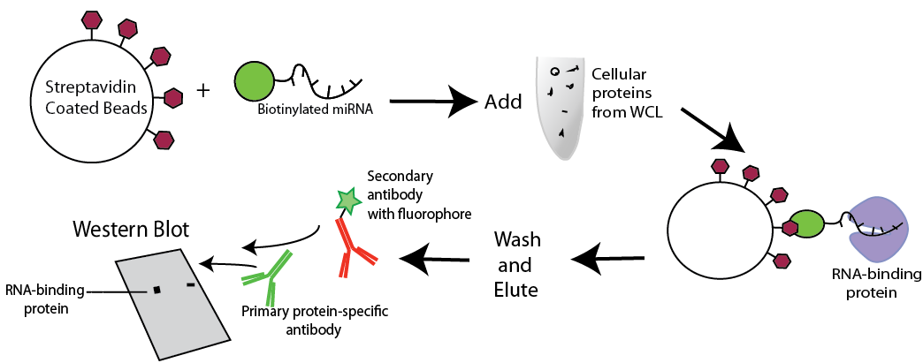
Aim 3: Verification of miR Candidate.
Method 1: Pull down assay

Slide 13
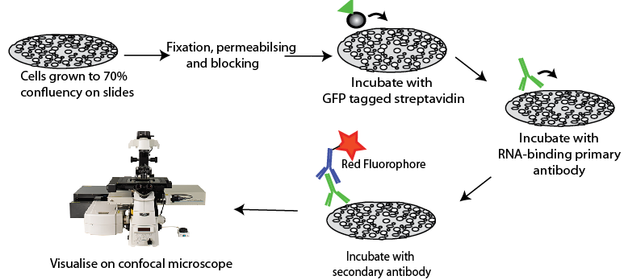
Aim 3: Verification of miR Candidate.
Method 2: Co-localisation by Immunofluorescence Confocal Microscopy
Cells transfected with biotinylated miRNAs
Co-localized miRNA + protein will be visualized as yellow.

Slide 14
Significance
Increases proliferation.
Novel mechanism of miRNA function
Irregularities in sorting can cause dysfunction in recipient cells.
MiRNAs exported within EVs have been linked to cancer metastasis

Slide 15



Acknowledgements
Supervisor: A/Prof Michelle Hill
Co-supervisor: Dr Alex Cristino
Hill Lab

